Slide 1
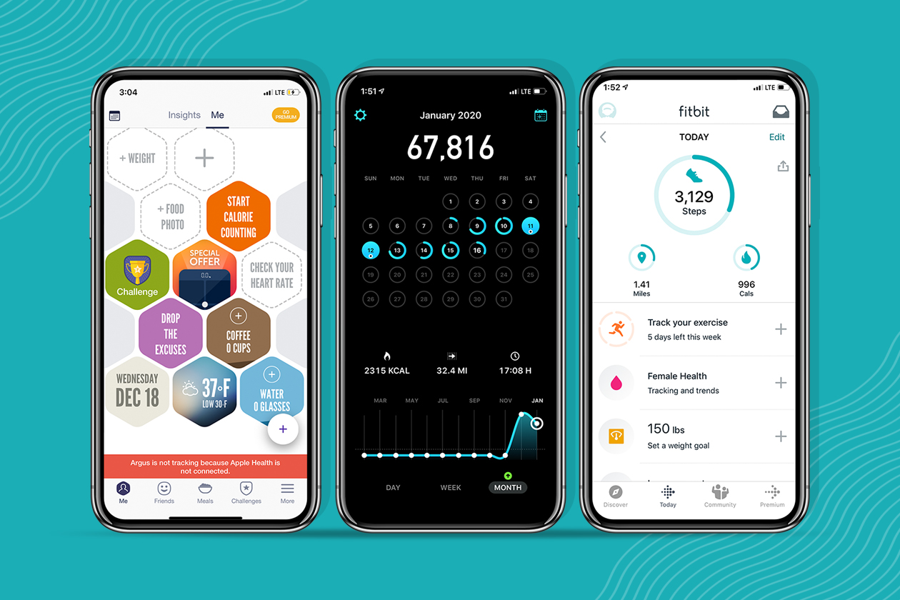

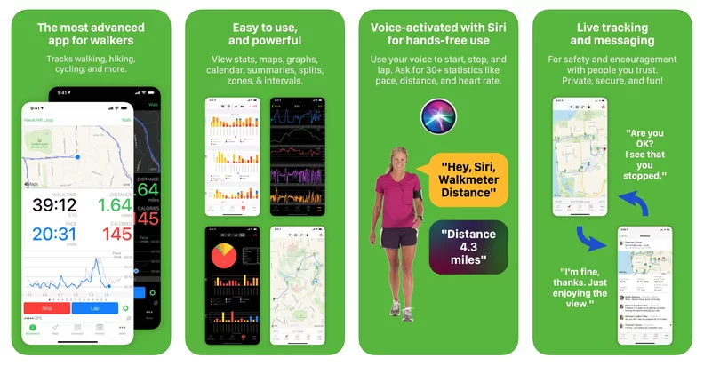
Step Up
StepUp: Your Personalized Walking Companion – Track your daily steps, set achievable goals, and stay motivated to live a healthier, more active life.
Team Members: Khedive Borland

